Slide 1


Credit Card Fraud Prediction - A Prototype User Guide (provisional)
Author: Ciaran Finnegan / DBS Student No. : 10524150
March 2019 Intake – Fri/Sat
E-mail: 10524150@mydbs.ie / ciaran@feefinnegan.com
Higher Diploma in Science in Data Analytics – B8IT110 Final Project

Slide 2

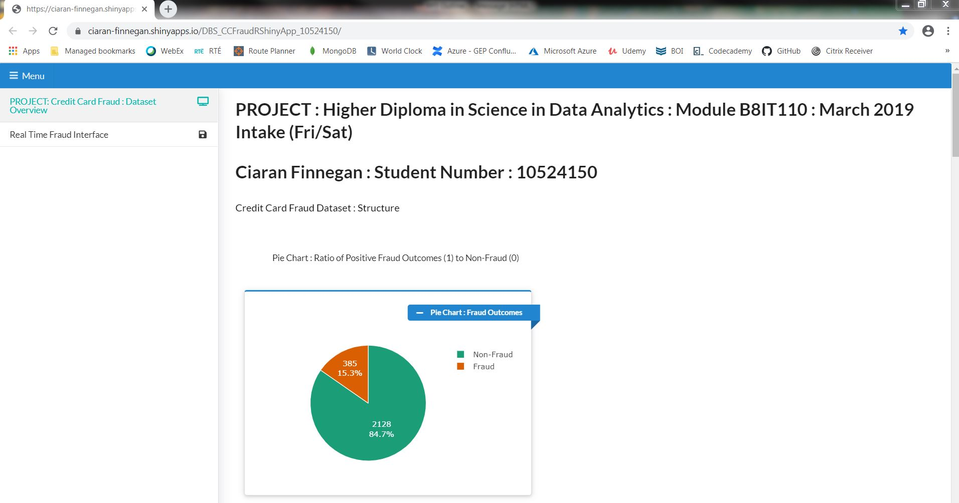
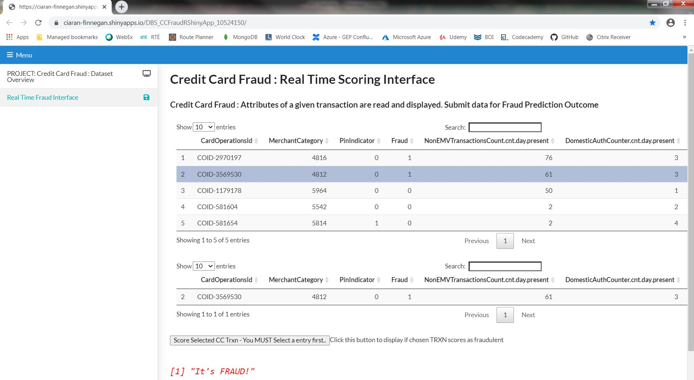
Credit card fraud prediction - UI
This prototype is a demonstration of working software at the interim stage of the project.
The final application artefact will vary in terms of functionality and the sophistication of the fraud modelling process.

Slide 3

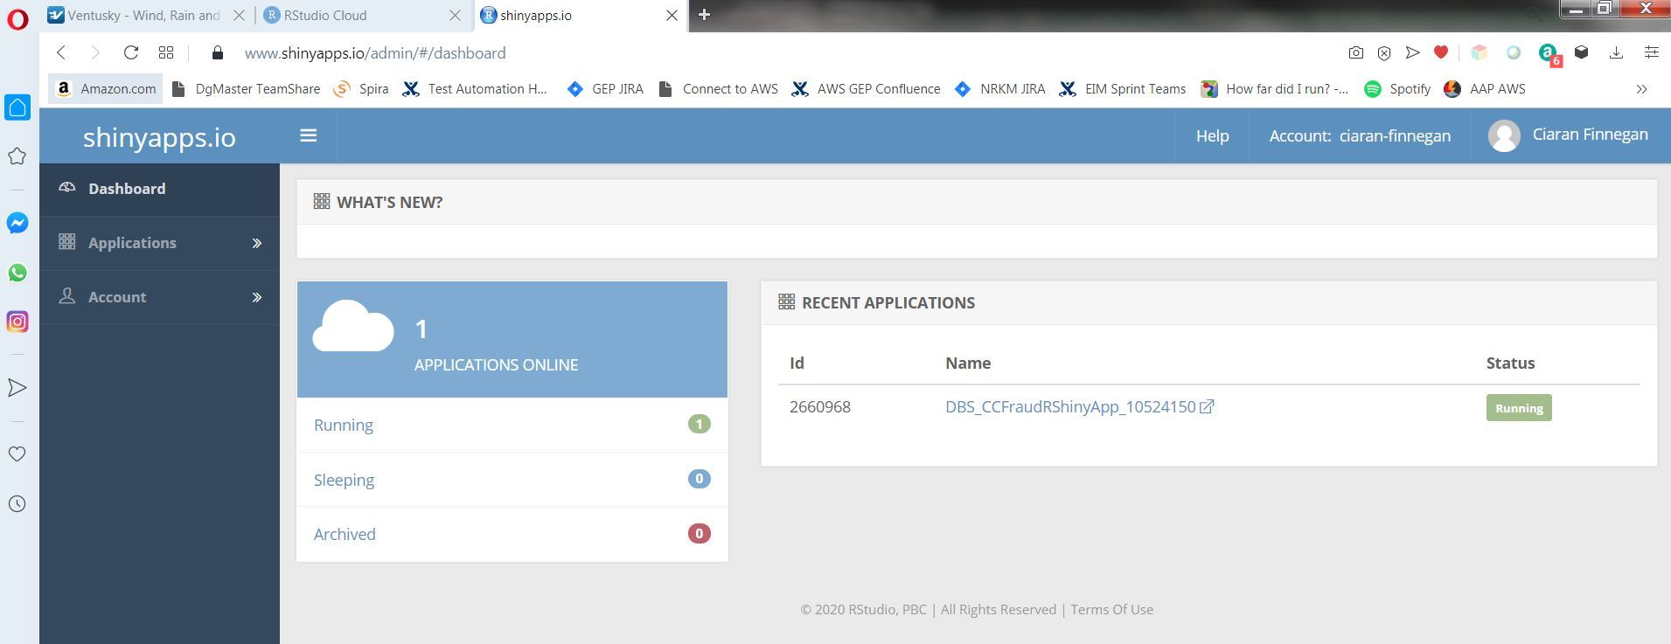
Credit card fraud prediction - UI
The application front end is a hosted Shiny R application dashboard.
To access..
https://ciaran-finnegan.shinyapps.io/DBS_CCFraudRShinyApp_10524150/

Slide 4


CC Fraud Dashboard
The prototype application has two tabs.
One for data visualisation on CC fraud dataset used for model creation
The other to provide an interface to check ‘new’ loaded cc trxns for fraud.

Slide 5
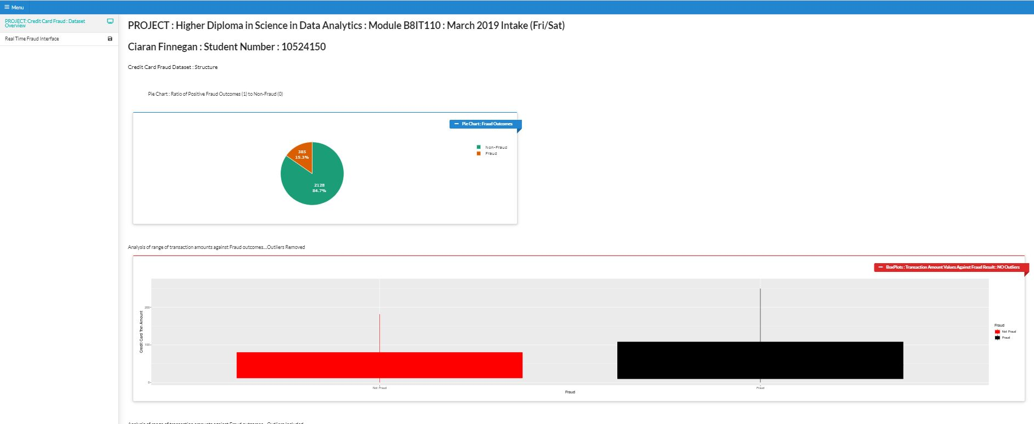
CC Fraud Dashboard (1)
Visualisations Tab (1)
The prototype limits itself to a representative sample of 2,500 rows for visualisation. (The primary dataset is 100K+ rows in size).
On screen visualisations are relatively straightforward. More complex/insightful graphs will follow later in the project.

Slide 6
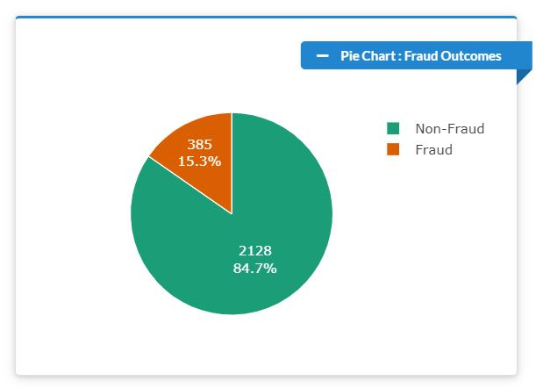
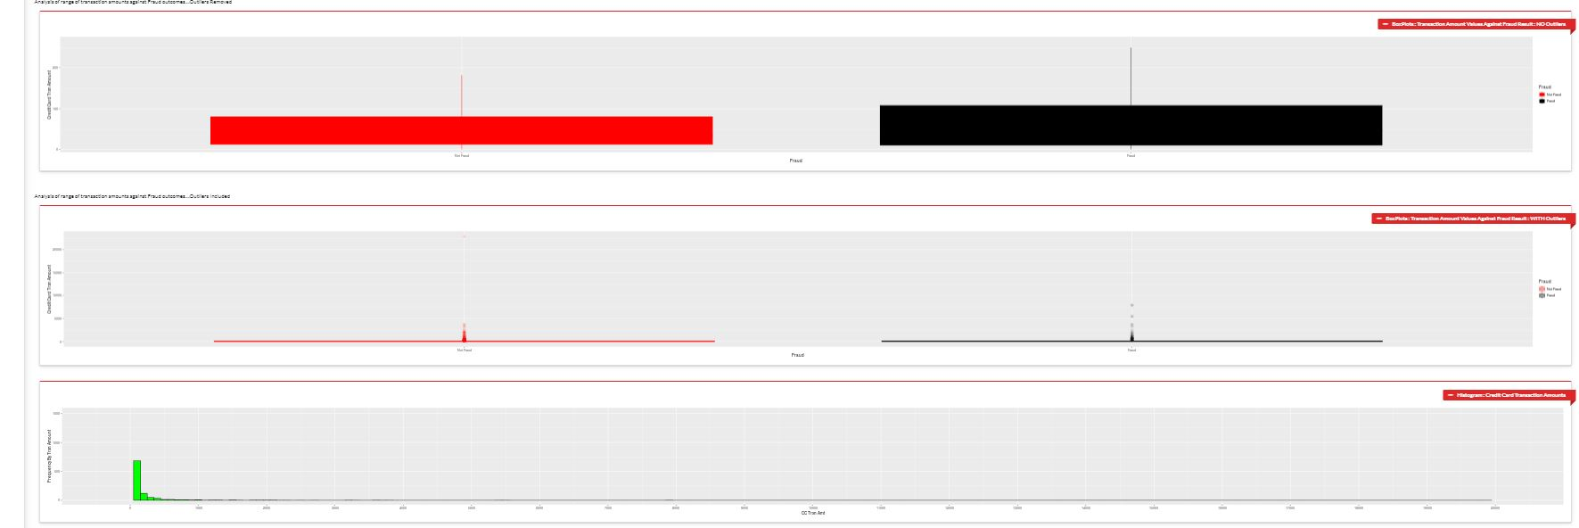
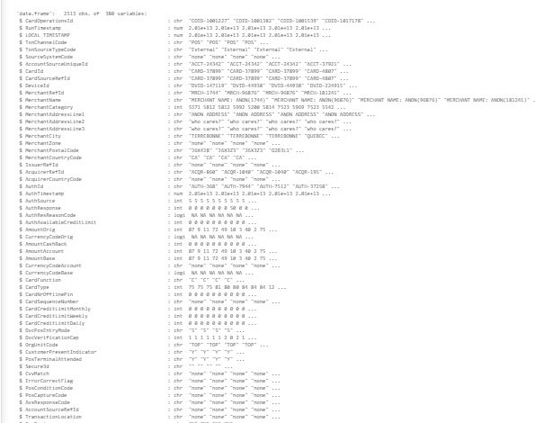
CC Fraud Dashboard (1)
Visualisations (2) –
The first graph shows the breakdown of Fraud/Non-Fraud records in the sample dataset.
The next three are box plots and a bar chart on the analysis of fraud based on the amount of the credit card transaction.
The last is a temporary test text output to show structure of the initial columns in the dataset.

Slide 7

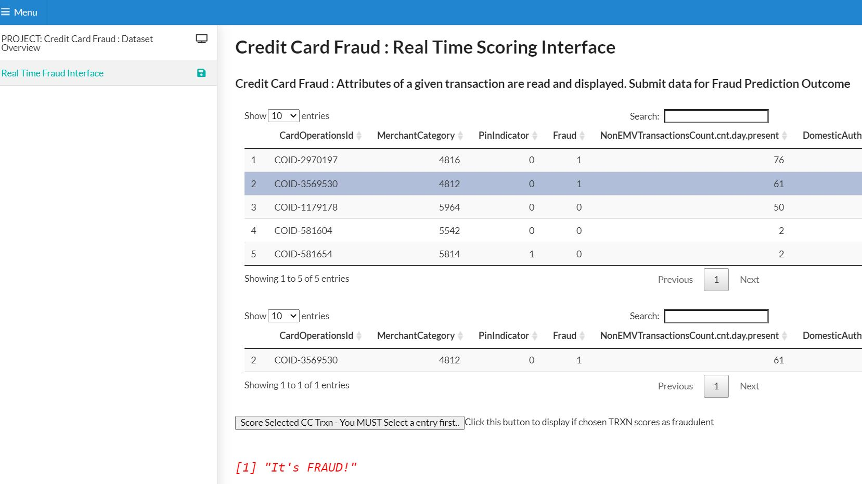

Fraud ‘ Production’ Interface (1)
The second tab has a basic workflow for checking a given credit card transaction for suspected fraud.
The purpose of this prototype is to demonstrate the end-to-end working of a deployed predictive fraud model, built and hosted in a separate Azure platform.
To emphasise this is a prototype to prove the viability of a ‘production’ framework for the predictive credit card fraud model – the final machine learning process and user interface will be more sophisticated.

Slide 8
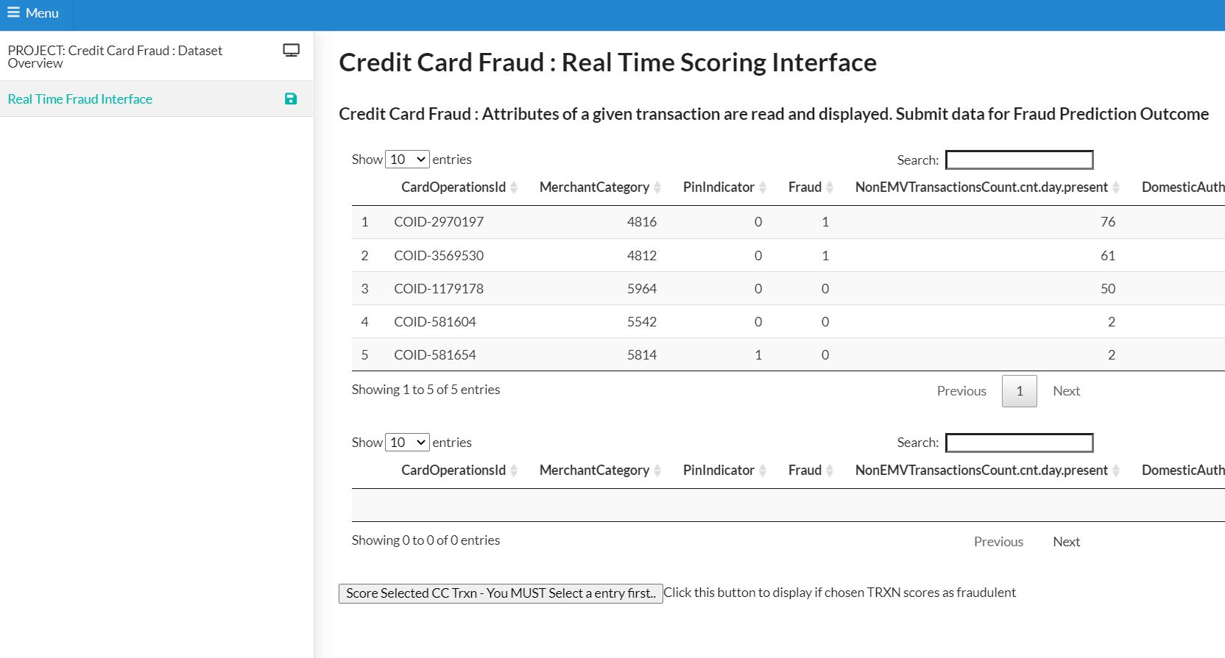
Fraud ‘ Production’ Interface (2)
These initial on screen records are obtained from a dedicated example dataset hosted in Azure. (The ‘Fraud’ label comes from the initial dataset – but it is not used in when the scoring model is invoked).
The screen initially loads with a set of five ‘new’ transactions

Slide 9
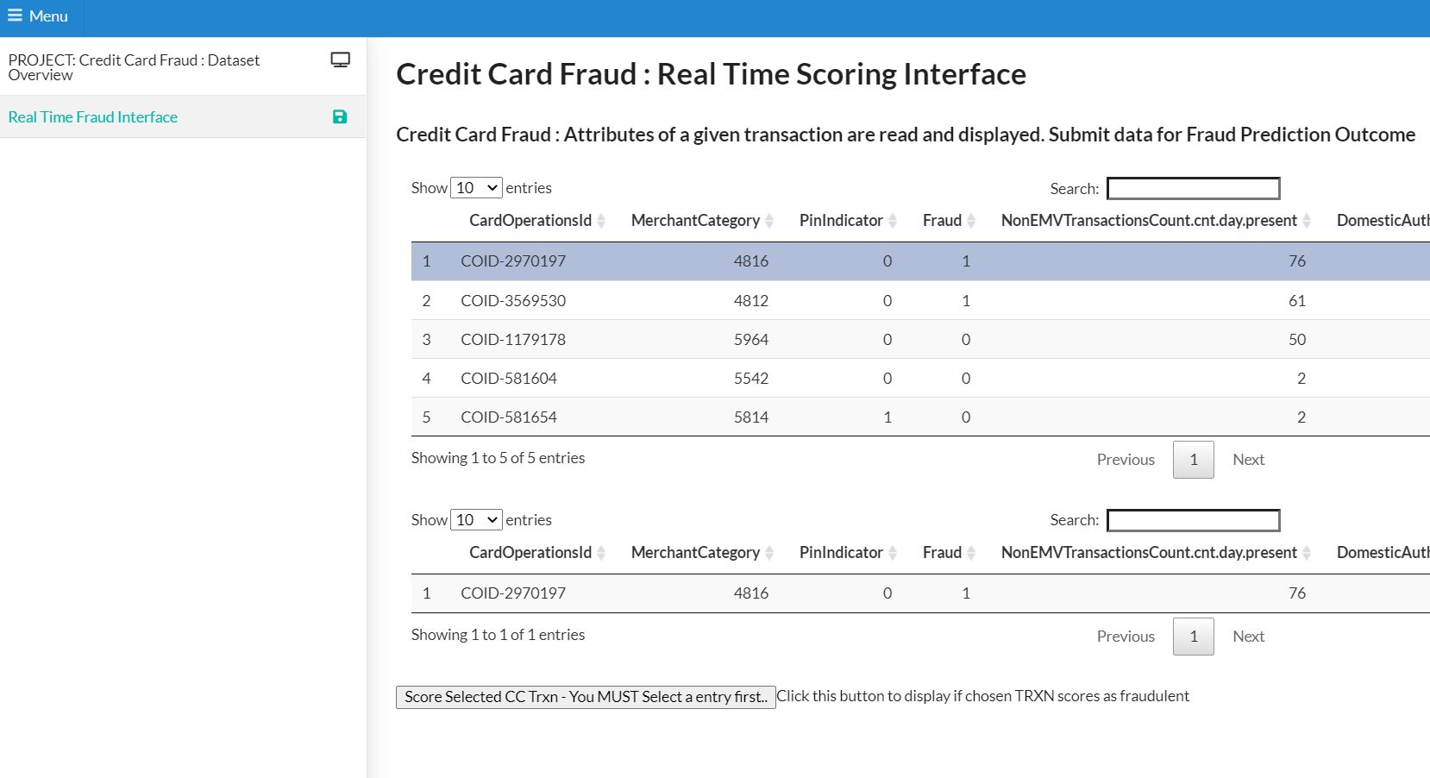
Fraud ‘ Production’ Interface (3)
The user must select a single transaction to populate the ‘selection’ data table.
A record has been successfully chosen if it is replicated in this data table

Slide 10
Fraud ‘ Production’ Interface (4)
The score the transaction and get a prediction about whether it is fraudulent, click this button

Slide 11
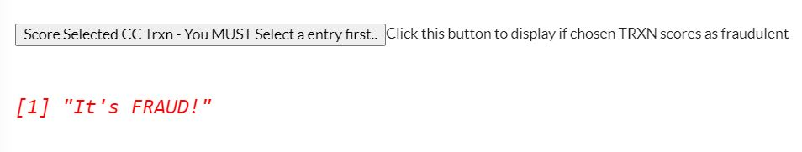
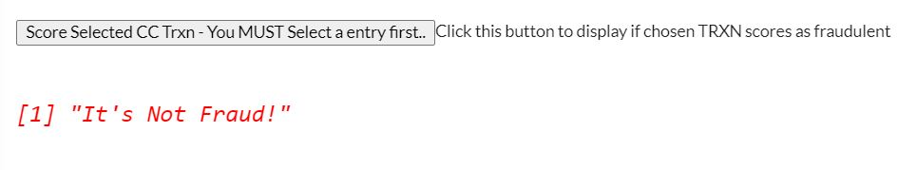
Fraud ‘ Production’ Interface (5)
An API is invoked with the attributes of the chosen transaction and the Azure hosted model returns a basic flag indicating Fraud (or not).

Slide 12
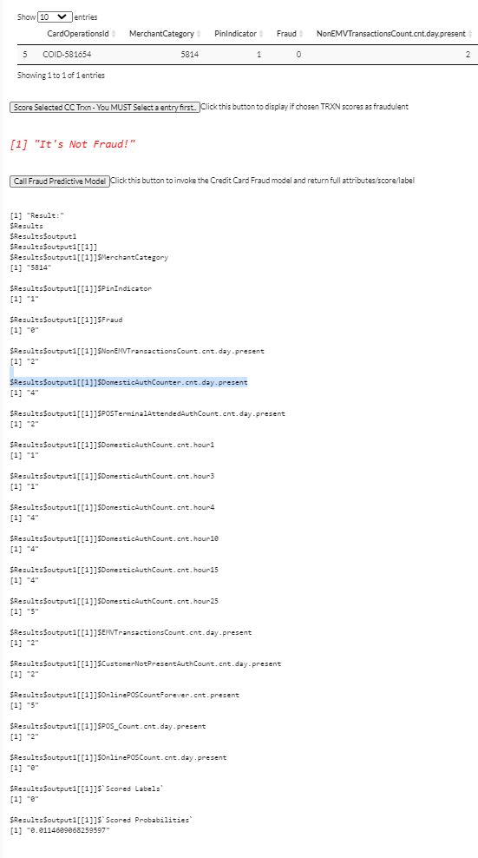
Fraud ‘ Production’ Interface (6)
For the purposes of the prototype, this button invokes the same Azure hosted API but returns the full response from the model, including the score value.

Slide 13

Project application – Remaining roadmap
Predictive Fraud Model
Prototype
Improved
Model
A more sophisticated model is built with full ML workflows, including enhanced data manipulation.
Interim Stage
This application and report.
Final Project Artefact
Enhanced
UI
Final Report / Deliverable
Improved Shiny R App
All refinements in place. Full documentation.
More advance Dashboard Visualizations and File Selection.

Slide 14


Invention design process
Talk about the design process
Did your first build work, or did you have to change your ideas? Why?
Did you have to change the materials you used as you tested your invention? Why?
<Insert pictures or drawings of your invention design/building process>
*you can insert a new slide for these pictures/drawings if you need to!

Slide 15

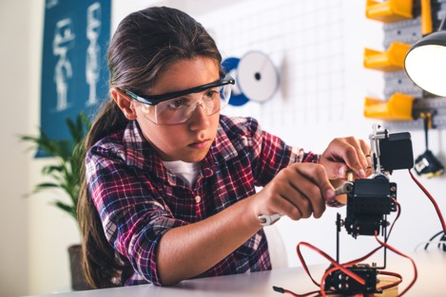
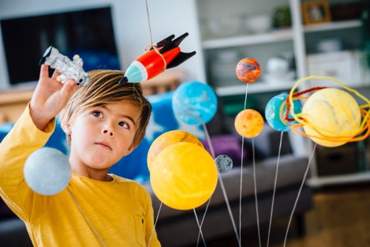

My invention in use!
Talk about how people reacted to your invention
Did it solve the problem/need you identified?
Did it work as planned? Did it help whom it needed to help?
<Insert pictures or drawings of your invention being used, with a description entered here>
*you can insert a new slide for these pictures/drawings if you need to!
<Insert pictures or drawings of your invention being used, with a description entered here>
*you can insert a new slide for these pictures/drawings if you need to!
<Insert pictures or drawings of your invention being used, with a description entered here>
*you can insert a new slide for these pictures/drawings if you need to!

Slide 16
Customise this template
Template editing instructions and feedback

